Slide 1

Comparison of VM Database service OF AWS,ORACLE GENI with GCP

Slide 2


Team Members
Name | Student ID
Grace Stalin | 16291038
Abdulsalam Elsaidi | 12342281

Slide 3

Type of Project
Development & Research with Evaluation

Slide 4

Motivation
The main motivation of this project are:
Free access to Cloud platforms like AWS, ORACLE and GENI with GCP.
To learn and experience developing concepts of Cloud computation.
Obtaining required knowledge and skills to work on real time Cloud projects in future.

Slide 5

Objective
Objective of this project are:
Set up the server, create and deploy the databases in Cloud platforms
Evaluate and Analyze VM performance benchmark using third party tool.

Slide 6
Architecture

Slide 7

First create AWS EC2
T2.large

Slide 8
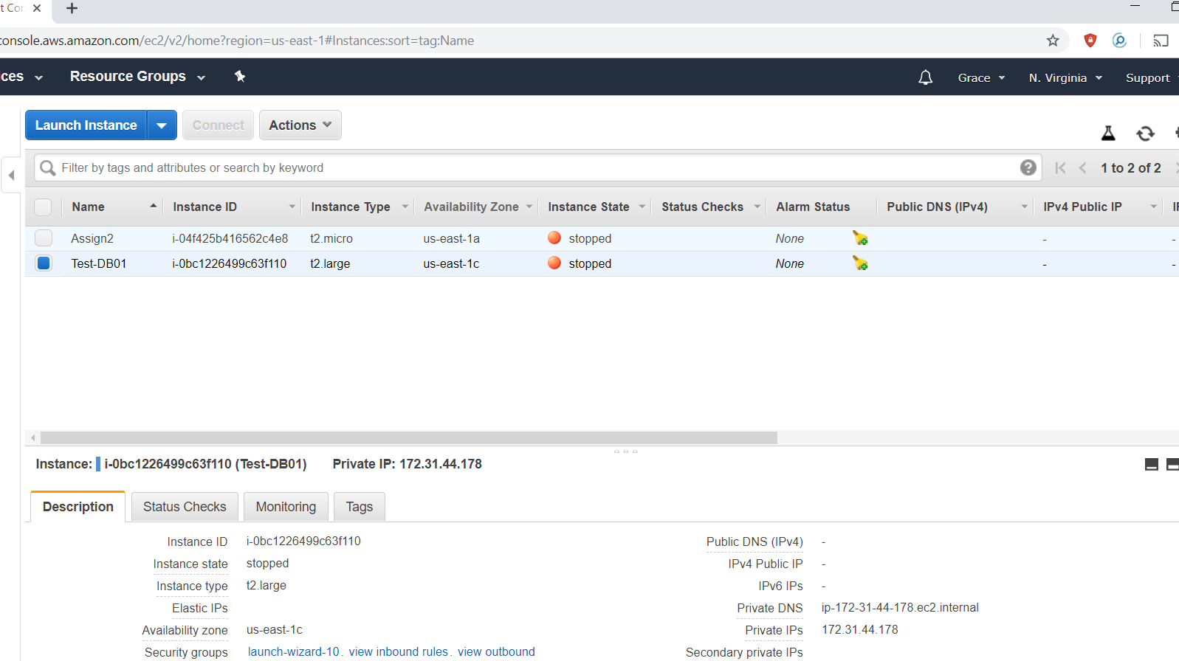
Instance EC2 created in AWS

Slide 9
Database prerequisite
Installing rpm package manager from oracle repository.
Create a user and groups to run oracle DB on oracle user.
Set password for oracle user.
Disable selinux (disable Linux firewall)permission.
Download oracle software from oracle edelivery.
Unzip the package .

Slide 10
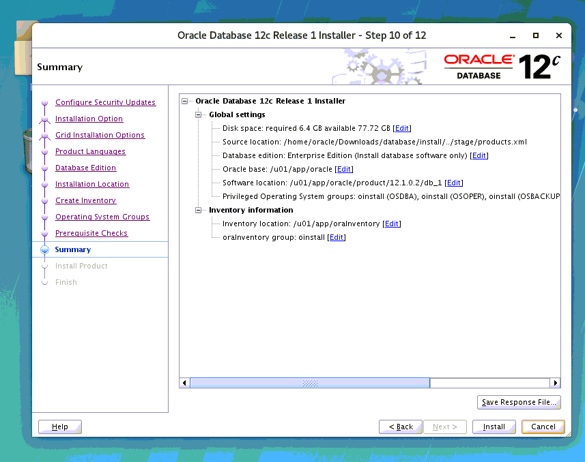
Oracle database installation
Install the oracle database 12c.
Create inventory to save the software location.

Slide 11
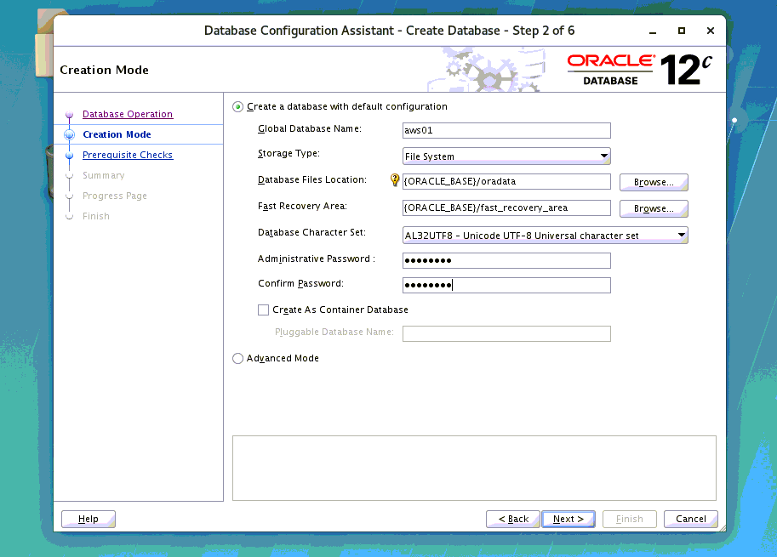
Database creation
Before creation Database create a listener (communication between client or server)
Create Database with password with following criteria.

Slide 12
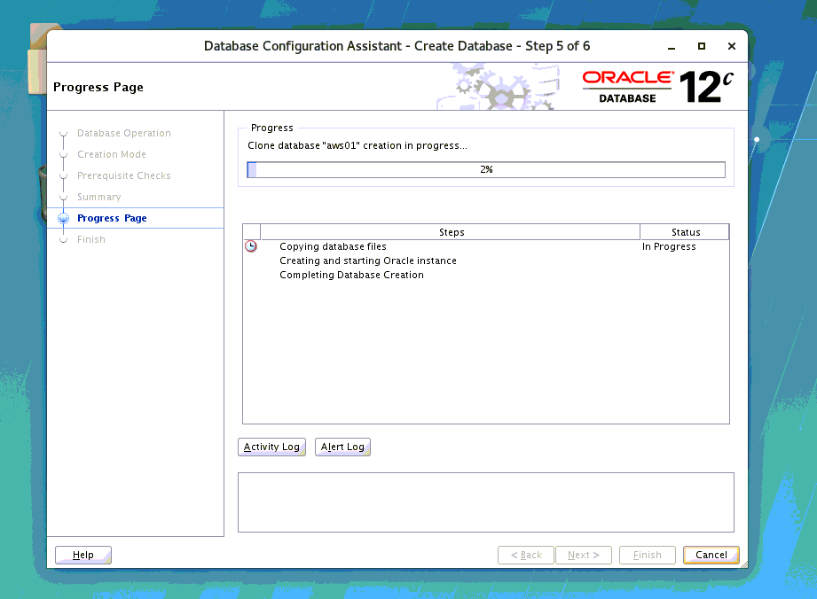
Database Created!!

Slide 13
Tools, Language & Platforms used
Tools | Language | OS
Oracle DB Solar wind or idera Tableau | SQL Sql developer (DB cloud) | Windows 2012RS Linux(Rhel 7.6)

Slide 14
Learning
Server setup
DB creation
Bench marking
Analyzing

Slide 15
THANK YOU
SEE you in the final presentation.

